Slide 1
Unit Testing

Slide 2
Introduction
It is the process used to identify the correctness, completeness and quality of developed computer software.
Example: C++ testing tools(Google Test, Boost Test), Java (selenium), Python(Pytest)

Slide 3
Objective
Uncover as many as errors (or bugs) as possible in a given product.
Demonstrate a given software product matching its requirement specifications.
Validate the quality of a software testing using the minimum cost and efforts.
Generate high quality test cases, perform effective tests, and issue correct and helpful problem reports.

Slide 4
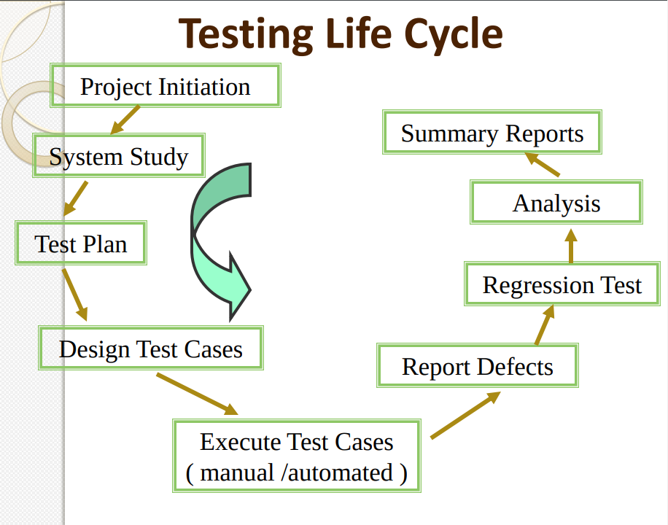
Image owner website: link

Slide 5
Testing Methodologies
Black Box Testing:
No Knowledge of program design or code
Test are based on requirements and functionality
White Box Testing:
Knowledge of internal program design and code
Test are based on paths, conditions

Slide 6
Testing Levels
Unit Testing:
Test each module individually
Done by developers
Tool Example : Boost Test, Google test
Integration Testing:
Tested after integration of unit modules
Tool Example : Selenium
System Testing:
System as a whole is tested
Requirements error
Tool Example : Selenium

Slide 7
Google Test
A library for writing c++ tests
An XUnit test framework
Open-source with new BSD license

Slide 8
Why Use Google Test
Independent and repeatable,
Tests should be well organized and reflect the structure of the tested code
Tests should be portable and reusable.
When tests fail, they should provide as much information about the problem as possible.
Tests should be fast.
Large community of supporters

Slide 9
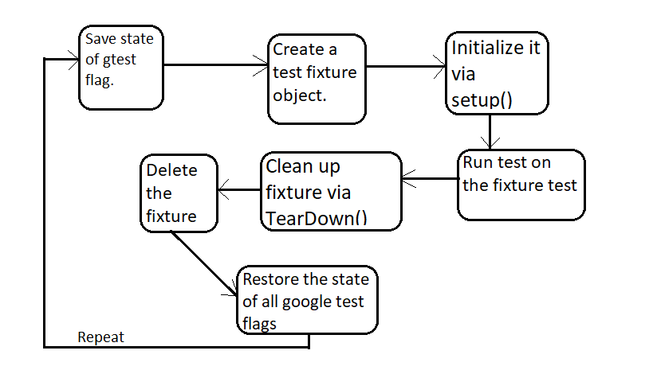
Architecture

Slide 10
Assertions
Basic Assertions: ASSERT_TRUE(cond), EXPECT_TRUE(cond),ASSERT_FALSE(cond)
Binary Comparison: ASSERT_EQ(val1,val2), ASSERT_NE(val1,val2),ASSERT_LT(val1,val2),
ASSERT_LE(val1,val2)
String Comparison: ASSERT_STREQ(str1,str2), ASSERT_NE(str1,str2), ASSERT_STRCASEEQ(str1,str2) , ASSERT_STRCASENE(str1,str2),
Death and Exception Test: Expect_DEATH(val,regx), ASSERT_THROW(statement, exception_type), ASSERT_ANY_THROW(statement).

Slide 11
Death Tests
In many applications, there are assertions that can cause application failure if a condition is not met.
If a piece of code throws an exception, we don't consider it "death" for the purpose of death tests,
Assertions:
EXPECT_DEATH(val, regx)
ASSERT_DEATH_IF_SUPPORTED(statement, regex);
ASSERT_EXIT(statement, predicate, regex);

Slide 12
Exception Test
These are for verifying that a piece of code throws (or does not throw) an exception of the given type.
ASSERTIONS:
ASSERT_THROW(statement, exception_type);
ASSERT_ANY_THROW(statement);
ASSERT_NO_THROW(statement);

Slide 13
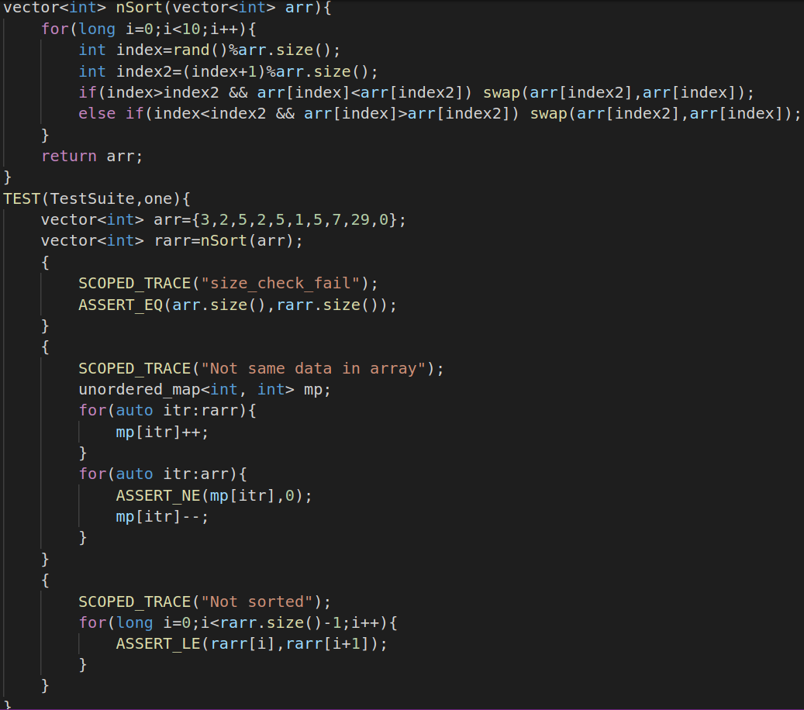
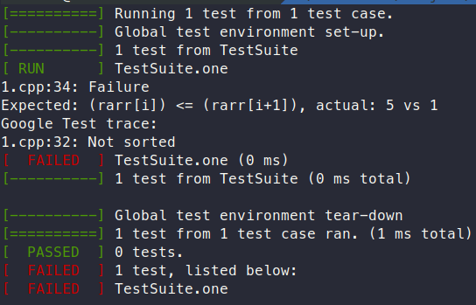
Test Example 1
Add for loop example

Slide 14
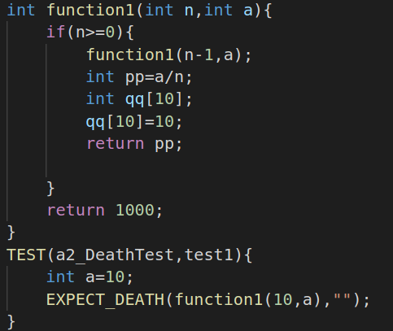
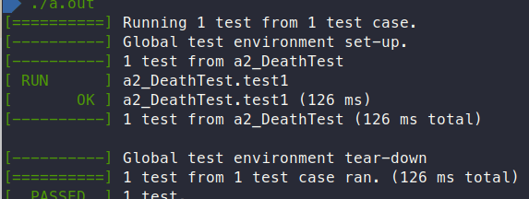
Test example 2
Any other exxample

Slide 15
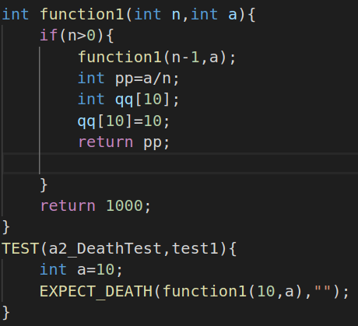
Test example 3
Any other exxample

Slide 16
Project Example
The Chromium projects (behind the Chrome browser and Chrome OS).
The LLVM compiler.
Protocol Buffers, Google's data interchange format.
The OpenCV computer vision library.
tiny-dnn: header only, dependency-free deep learning framework in C++11.

Slide 17
Limitations
Google Test is designed to be thread-safe. The implementation is thread-safe on systems where the pthreads library is available. It is currently unsafe to use Google Test assertions from two threads concurrently on other systems (e.g. Windows). In most tests this is not an issue as usually the assertions are done in the main thread.

Slide 18
Boost Test
A library for writing c++ tests
An XUnit test framework
Boost Software License

Slide 19
Why Use Boost Test
The framework provides a uniform (and well-supported) testing and reporting environment.
Using the framework simplifies the process of creating and maintaining unit tests:
extensible logging, XML and JUNIT outputs for third-party tools (eg. cont. integration)
provide assertion context for advanced diagnostic on failure
powerful and extensible dataset tests

Slide 20
Boost.test vs GTest
Boost.Test | Google Test
Does not support mock object. | Support mock object.
Extended feature with event mechanism not supported. | Extended feature with event mechanism supported.
Does not support distributed machine architecture. | Support distributed machine architecture
Does not provide thread safety while running. | Provide thread safety.

Slide 21
Assertions
BOOST_TEST(predicate)
BOOST_CHECK(predicate)
BOOST_WARN(predicate)
BOOST_REQUIRE(predicate)
BOOST_CHECK_EQUAL(val1,val2)
BOOST_WARN_EQUAL(val1,val2)
BOOST_REQUIRE_EQUAL(val1,val2)

Slide 22
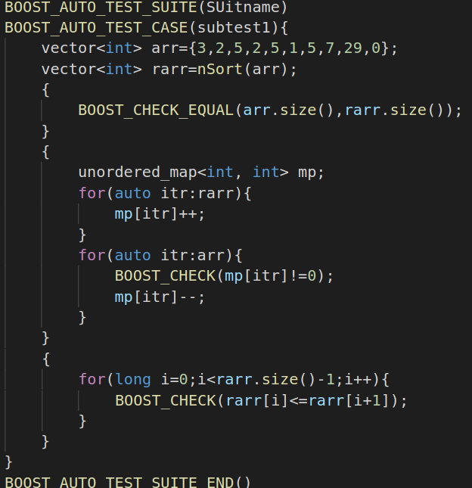
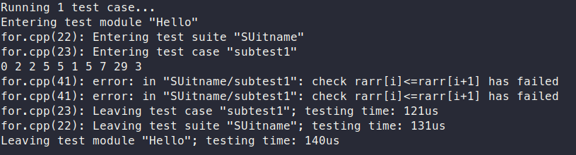
Test Example 1
Add for loop example

Slide 23
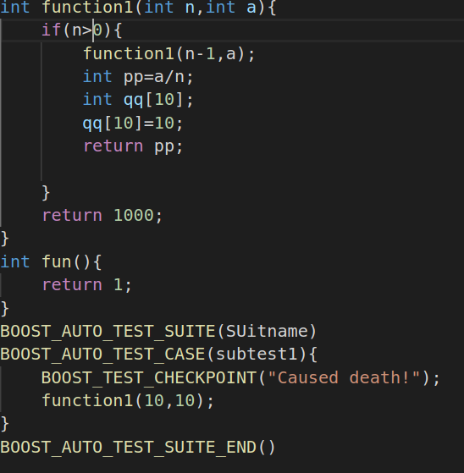
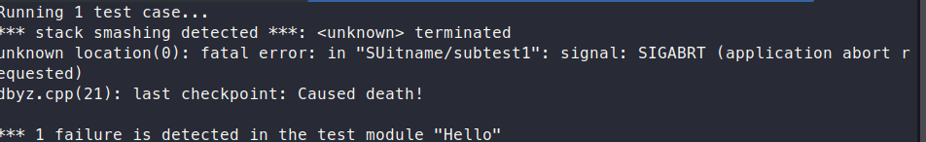
Test example 2
Any other exxample

Slide 24
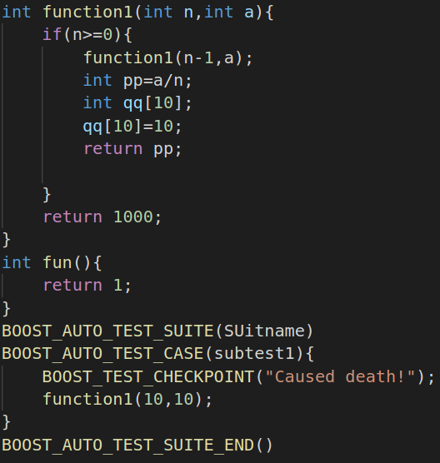
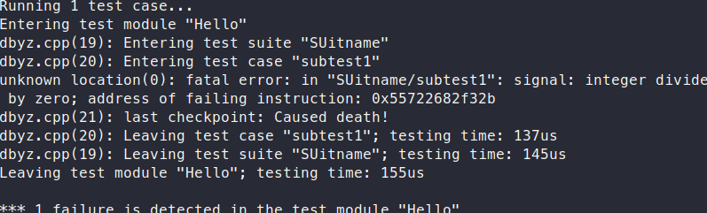
Test example 3
Any other exxample

Slide 25
Limitation
It is not suitable for most multi-threaded tests.
It is not suitable for “one-piece” applications (such as server or CGI). Such applications should be tested via their clients (which would preferably be unit test based).

Slide 26
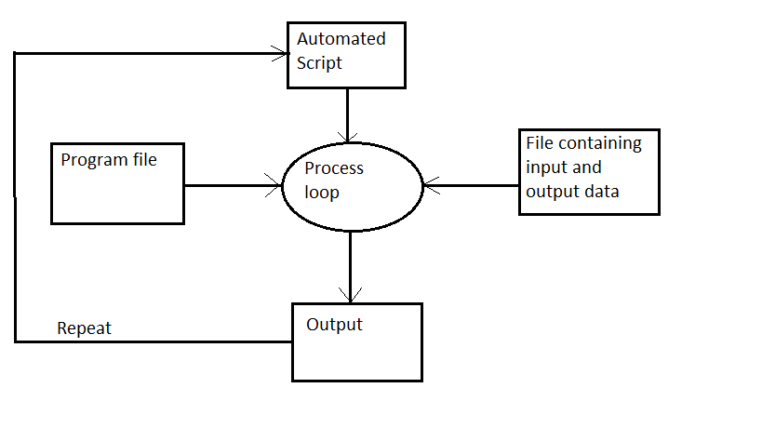
Manual Testing

Slide 27
Manual Test vs Test Library
Manual Test | Test Library
Not Portable, depends on RTTI, compilers | Portable, does not depends on RTTI, Compilers
Manual start of test units | Automatically detects test units
Does not share resource across tests. | Share resource across tests.
Mock object, Distributed machine not supported | Mock object, distributed machine supported

Slide 28
References
https://www.boost.org/doc/libs/1_45_0/libs/test/doc/html/utf.html
https://www.boost.org/doc/libs/1_45_0/libs/test/doc/html/utf/tutorials.html
https://github.com/boostorg/test
http://alexott.net/en/cpp/CppTestingIntro.html
https://github.com/google/googletest
https://github.com/google/googletest/blob/master/googletest/docs/primer.md
https://github.com/google/googletest/blob/master/googlemock/README.md
https://en.wikipedia.org/wiki/XUnit

